Slide 1
WEB FORMS
ASP.NET pages (officially known as web forms) are a vital part of an ASP.NET application.
Provide the actual output of a web application—the web pages that clients request and view in their browsers.
Web forms allow you to create a web application using the some control-based interface as a Windows application.

Slide 2
Page Processing
Goal of ASP.NET developers is to develop web forms in the same way that Windows developers can build applications.
Web applications are very different from traditional rich desktop/client applications:
Web applications execute on the server.
Web applications are stateless.

Slide 3
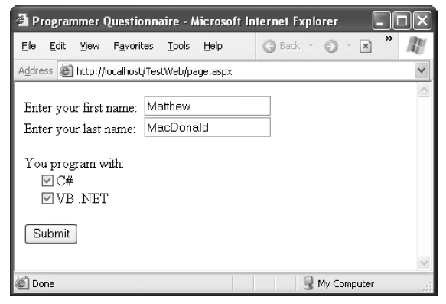
HTML Forms
Simplest way to send client-side data to the server is using a <form> tag
Inside the <form> tag, can place other <input> tags to represent basic user interface ingredients

Slide 4
HTML Forms cont..
ASP.NET uses control model.
string firstName = txtFirstName.Text;

Slide 5
Dynamic User Interface
Control model makes life easier for retrieving form information
In classic ASP insert a script block that would write the raw HTML
string message = "<span style=\"color:Red\">Welcome " +
FirstName + " " + LastName + "</span>";
Response.Write(message);
On the other hand, with Label control in ASP.NET
<asp:Label id="lblWelcome" runat="server" />
Now you can simply set its properties
lblWelcome.Text = "Welcome " + FirstName + " " + LastName;
lblWelcome.ForeColor = Color.Red;
Note: Not Necessary to KNOW HTML markup syntax.
Hides the low-level HTML details.

Slide 6
The ASP.NET Event Model
Classic ASP uses a linear processing model.
Code execution is from start to end.
More code for even simple web page.
(Example of three buttons on HTML form)
script code must determine which button is clicked
and execute code accordingly
ASP.NET provides event-driven model.

Slide 7
The ASP.NET Event Model cont..
Here’s a brief outline of event driven model:
Your page runs for the first time. ASP.NET creates page, & control objects, the initialization code executes, and then the page is rendered to HTML and returned to the client.
At some point, the user does something that triggers a postback, such as clicking a button. & page is submitted with all the form data.
ASP.NET intercepts the returned page and re-creates the page objects.

Slide 8
The ASP.NET Event Model cont..
4. Next, ASP.NET checks what operation triggered the postback, and raises the appropriate event procedure.
5. The modified page is rendered to HTML and returned to the client. The page objects are released from memory.
If another postback occurs, ASP.NET repeats the process in steps 2 through 4.

Slide 9
POSTBACK
1.User request web form from server
2.Web server respond back with requested web form.
3.User enters the data and submits the form to web server.
4.Web server process the form and sends the result back to the client
Step 3 ????
Step 3 & Step 4 ????
PostBack is the name given to the process of submitting an ASP.NET page to the server for processing.

Slide 10
Automatic Postbacks
All client action cannot be handled. e.g. mouse movement because of server side processing.
If want to do, can use Java Script or Ajax.
ASP.NET web controls extend this model with an automatic postback feature.
To use automatic postback set the AutoPostBack property of a web control to true (the default is false)
ASP.NET adds a JavaScript function to the rendered HTML page named __doPostBack() (AutoPostBack =true)

Slide 11
View State
View state solves another problem that occurs because of the stateless nature of HTTP—lost changes.
ASP.NET has its own integrated state serialization mechanism.
ASP.NET examines all the properties, if changed makes a note of this information in a name/value collection.
ASP.NET takes all the information it has collected and then serializes it as a Base64 string.

Slide 12
View State cont..
The next time the page is posted back, ASP.NET follows these steps:
ASP.NET re-creates the page and control objects based on its defaults (first requested state)
Next, ASP.NET deserializes the view state information and updates all the controls.
ASP.NET adjusts the page according to the posted back form data.
Now event-handling code can get involved.
e.g. code can react to change the page, move to a new page, or perform a completely different operation.

Slide 13
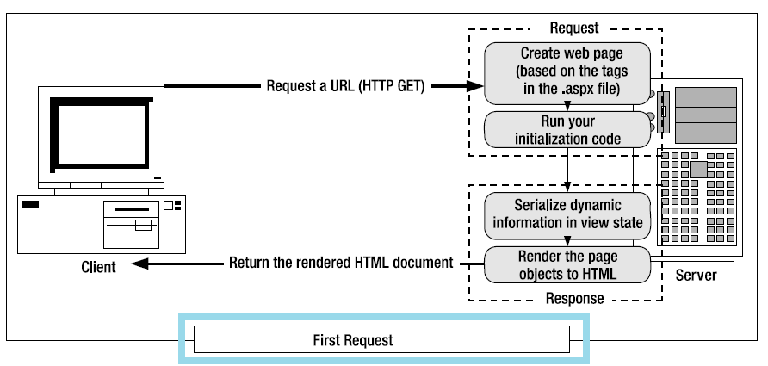
View State (First Request) cont..

Slide 14
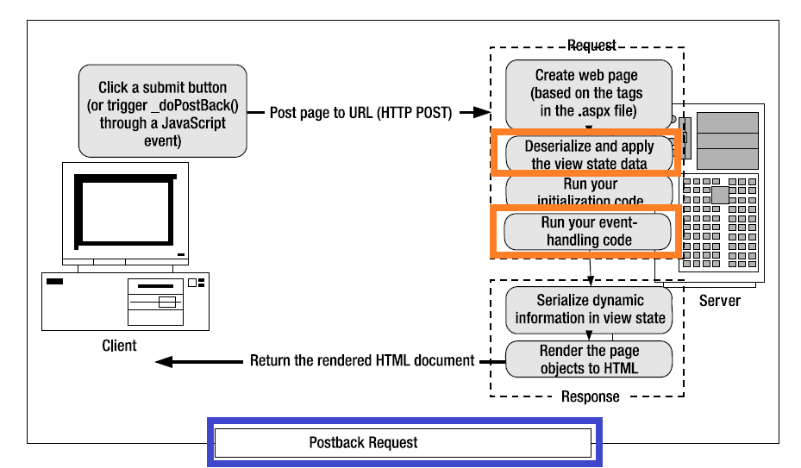
View State(Postback Request) cont..

Slide 15
View State cont..
Note: Even if you set EnableViewState to false, the control can still hold onto a smaller amount of view state information.
This privileged view state information is known as control state, and it can never be disabled.
Note: It is absolutely essential to your success as an ASP.NET programmer to remember that the web form is re-created with every round-trip. It does not persist or remain in memory longer than it takes to render a single request.

Slide 16
Web Forms Processing Stages
On the server side, processing an ASP.NET web form takes place in stages.
The following list shows the major processing stages
• Page framework initialization
• User code initialization
• Validation
• Event handling
• Automatic data binding
• Cleanup

Slide 17
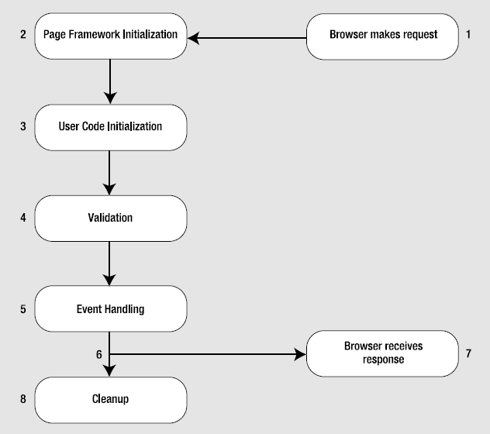
Web Forms Processing Stages cont..

Slide 18
Page Framework Initialization
ASP.NET first creates the page
Generates all the controls defined
ASP.NET deserializes the view state information (not being requested for the first if it’s postback),
Next Page.Init event fires (rarely handled by the web page, because it’s still too early to perform page initialization)

Slide 19
User Code Initialization
At this stage of the processing, the Page.Load event is fired.
The Page.Load event always fires, regardless of whether the page is being requested for the first time or whether it is being requested as part of a postback.
To determine the current state of the page, check the IsPostBack property of the page, which will be false the first time the page is requested. Here’s an example:
if (!IsPostBack)
{
// It's safe to initialize the controls for the first time.
FirstName.Text = "Enter your name here";
}

Slide 20
Validation
ASP.NET includes validation controls that can automatically validate other user input controls and display error messages.
Validation controls fire after the page is loaded but before any other events take Place.
validation controls are self-sufficient

Slide 21
Event Handling
At this point, the page is fully loaded and validated.
ASP.NET will now fire all the events since the last postback
Immediate response events
Change events
ASP.NET’s event model is still quite different from a traditional Windows environment
If you change text in the text box and click submit button, ASP.NET raises all of the following events (in this order):
• Page.Init
• Page.Load
• TextBox.TextChanged
• Button.Click
• Page.PreRender
• Page.Unload

Slide 22
Automatic Data Binding
When you use the data source controls, ASP.NET automatically performs updates and queries against your data source as part of the page life cycle.
Changes are performed after all the control events have been handled but just before the Page.PreRender event fires.
After the Page.PreRender event fires, the data source controls perform their queries and insert the retrieved data into linked controls.
This is the last stop in the page life cycle.
Page.PreRender is last action before the page is rendered into HTML.

Slide 23
Cleanup
At the end of its life cycle, the page is rendered to HTML.
Page.Unload event is fired.
At this point, the page objects are still available, but the final HTML is already rendered and can’t be changed.
garbage collection service that runs periodically to release memory tied to objects
unmanaged resources must be to release explicitly (e.g. Windows file handles and ODBC database connections)
When the garbage collector collects the page, the Page.Disposed event fires.

Slide 24
Summary of Web Forms Processing Stages
Page framework initialization
• User code initialization
• Validation
• Event handling
• Automatic data binding
• Cleanup

Slide 25
The Page As a Control Container
To render a page, the web form needs to collaborate with all its constituent controls.
When ASP.NET first creates a page, it inspects the .aspx file for each element it finds with the runat="server" attribute, it creates and configures a control object, and then it adds this control as a child control of the page.
Page.Controls collection contains all child controls on the page
ASP.NET models the entire page using control objects, including elements that don’t correspond to server-side content.

Slide 26
The Page Header
Web form can also contain a single HtmlHead control, which provides server-side access to the <head> tag.
Visual Studio default is to always make the <head> tag into a server-side control
Head includes other details such as the title, metadata tags (useful for providing keywords to search engines)
Title: This is the title of the HTML page
StyleSheet: IStyleSheet object that represents inline styles

Slide 27
The Page Class
All web forms are actually instances of the ASP.NET Page class (System.Web.UI namespace)
Code-behind class explicitly derives from System.Web.UI.Page.
means that every web form you create is equipped with an enormous amount of out-of-the-box functionality
Page class gives your code the following extremely useful properties:
• Session
• Application
• Cache
• Request
• Response
• Server
• User
• Trace

Slide 28
Session, Application, and Cache
The Session object is an instance of the System.Web.SessionState.HttpSessionState class.
The Session object provides dictionary-style access to a set of name/value pairs.
Session state is often used to maintain user specific information.
The Application object is an instance of the System.Web.HttpApplicationState class
Data is global to the entire application.
Cache object is an instance of the System.Web.Caching.Cache class.
Scalable storage mechanism because ASP.NET can remove objects if server memory becomes scarce.

Slide 29
Request Object
An instance of the System.Web.HttpRequest class.
Object represents the values and properties of the HTTP request
contains all the URLparameters and all other information sent by a client.
Much of the information provided by the Request object is wrapped by higher-level abstractions.
Can examine cookies

Slide 30
Request Object cont..
Property | Description
AnonymousID | identifies the current user
ApplicationPath and PhysicalApplicationPath | ApplicationPath gets the ASP.NET application’s virtual directory (URL), while PhysicalApplicationPath gets the “real” directory.
Browser | provides a link to an HttpBrowserCapabilities object
ClientCertificate | HttpClientCertificate object that gets the security certificate for the current request
Cookies | gets the collection of cookies sent with this request

Slide 31
Request Object cont..
Property | Description
Form | Represents the collection of form variables that were posted back to the page.
Headers and ServerVariables | collection of HTTP headers and server variables, indexed by name.
IsAuthenticated & IsSecureConnection | These return true if the user has been successfully authenticated and if the user is connected over SSL (Secure Sockets Layer).
IsLocal | This returns true if the user is requesting the page from the local computer.
QueryString | provides the parameters that were passed along with thequery string.

Slide 32
Request Object cont..
Property | Description
Url and UrlReferrer | Uri object that represents the current address for the page and the page where the user is coming from
UserAgent | a string representing the browser type.
UserHostAddress and UserHostName | get the IP address and the DNS name of the remote client
UserLanguages | provides a sorted string array that lists the client’s language preferences.

Slide 33
Response object
Response object is an instance of the System.Web.HttpResponse class
HttpResponse does still provide some important functionality—namely, cookie and Redirect() method

Slide 34
Response object cont..
Member | Description
BufferOutput | Can set true or false
Cache | HttpCachePolicy object that allows you to configure output caching
Cookies | collection of cookies sent with the response
Expires and ExpiresAbsolute | these properties to cache the rendered HTML
sClientConnected | Boolean value indicating whether the client is still connected to the server
Redirect() | transfers the user to another page in your application or a different website
Write() | write text directly to the response stream.
BinaryWrite() and WriteFile() | allow you to take binary content from a byte array or from a file and write it directly to the response stream

Slide 35
Server Object
Server object is an instance of the System.Web.HttpServerUtility class.
Member | Description
MachineName | Computer name of the computer on which the page is running.
GetLastError() | Retrieves the exception object for the most recently encountered error.
HtmlEncode() and HtmlDecode() | Changes an ordinary string into a string with legal HTML characters (and back again).
UrlEncode() and UrlDecode() | Changes an ordinary string into a string with legal URL characters (and back again).

Slide 36
Server Object cont..
Member | Description
UrlTokenEncode() and UrlTokenDecode() | Performs the same work as UrlEncode() and UrlDecode(), except they work on a byte array that contains Base64-encoded data.
MapPath() | Returns the physical file path that corresponds to a specified virtual file path.
Transfer() | Transfers execution to another web page in the current application.

Slide 37
Common HTML Entities
Result | Description | Encoded Entity
 | Non breaking space | &nbsp;
< | Less-than symbol | &lt;
> | Greater-than symbol | &gt;
& | Ampersand | &amp;
" | Quotation mark | &amp;

Slide 38
User Object
User object represents information about the user making the request of the web server
allows you to test that user’s role membership.
Implements System.Security.Principal.Iprincipal
can authenticate a user based on specific class depends Windows account information using IIS or through cookie-based authentication with a dedicated login page.

